Slide 1
Cluster Analysis

Slide 2
Cluster-wise Statistics
Mean By Clusters
Cluster | Fresh | Milk | Grocery | Frozen | Detergents_Paper | Delicassen
1 | 12035.7 | 4032.857 | 5489.269 | 2907.292 | 1713.535 | 1249.194
2 | 11717.8 | 19867.551 | 27597.102 | 4385.694 | 12201.327 | 3724.653
Region and Channel Tabulation by Clusters
Region= Lisnon
Hotel/Rest/Cafe Retail Channel
Cluster-1 58 11
Cluster- 2 1 7
Region= Oporto
Hotel/Rest/Cafe Retail Channel
Cluster-1 27 11
Cluster- 2 1 8
Region= Others
Hotel/Rest/Cafe Retail Channel
Cluster-1 207 77
Cluster- 2 4 28

Slide 3
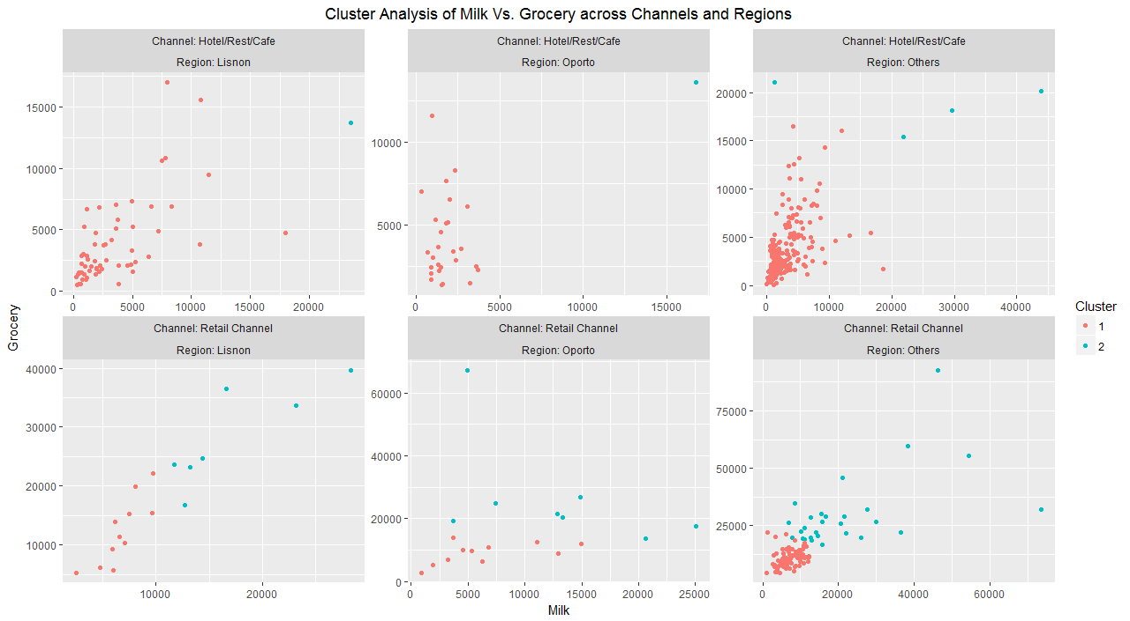

Slide 4
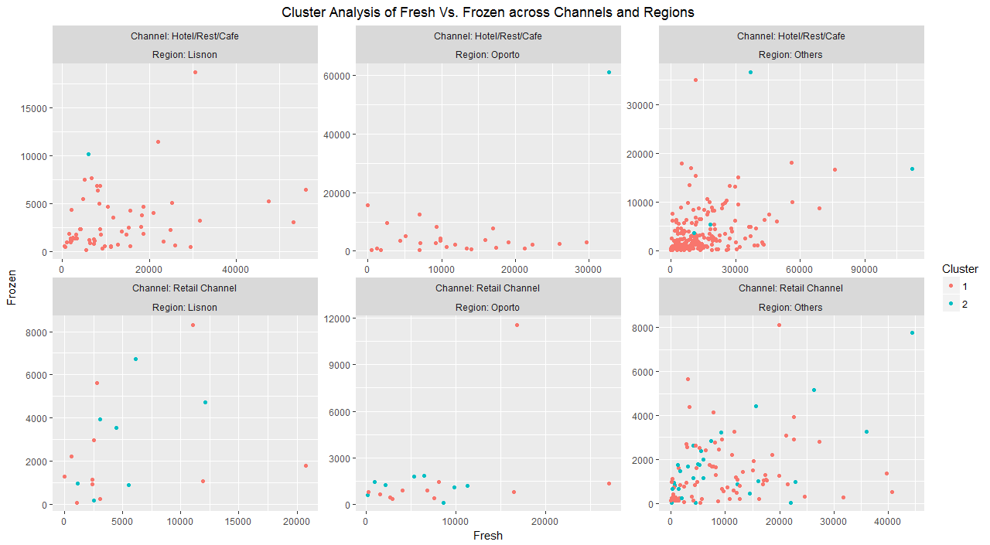

Slide 5
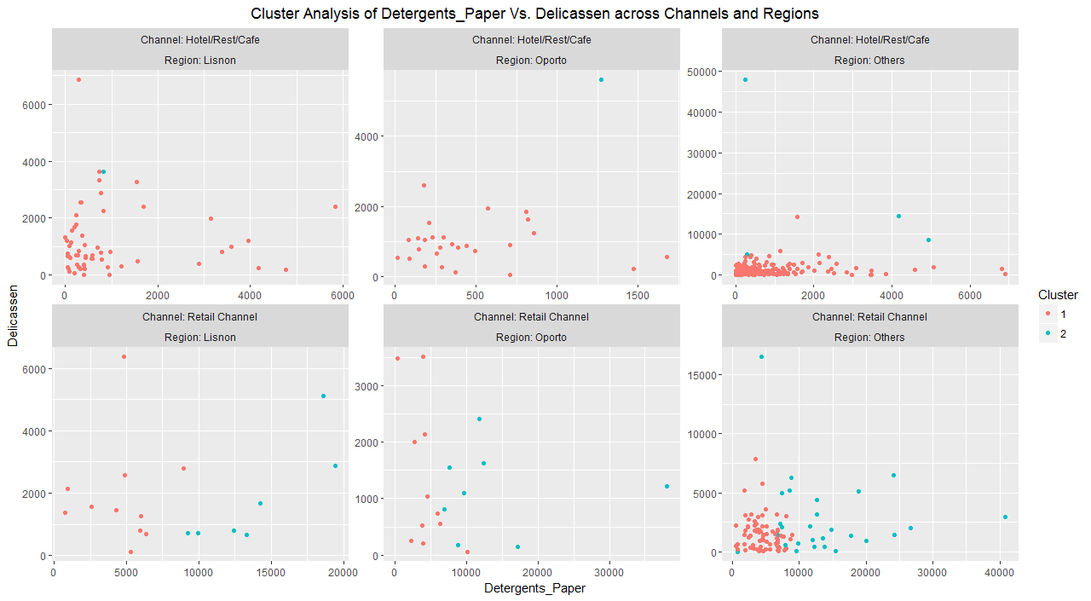

Slide 6
Key Insights
Cluster-2 groups the higher spending Channels and Regions
Among the Higher Spends, Retail Channel is the top contributor
In the Region of Lisnon the following are observed
Annual Spending of the Channel-Hotels/Restaurants/Café is highest in Fresh Products followed by Grocery, Milk and Frozen Foods whereas in the Retail Channel it is Grocery, Milk ,Detergents and Paper Products
In the Region of Oporto the following are observed
Annual Spending of the Channel-Hotels/Restaurants/Café is higher in Fresh Products and Grocery whereas in the Retail Channel it is Grocery, Milk Products, Fresh, Detergent and Paper Products

Slide 7
Key Insights
Among the Other Regions the following are observed
Annual Spending of the Channel-Hotels/Restaurants/Café is higher in Fresh Products, Frozen, Milk Products and Grocery whereas in the Retail Channel it is Grocery, Milk Products, Fresh, Detergent and Paper Products

